Slide 1
DEBIT & CREDIT TRANSACTIONS
BANKING DATA
BY HARIOM CHAUDHARY

Slide 2
INTRODUCTION
Credit and Debit Transaction Analytics Project deals with the transactional bank data, analyzing which illuminated certain patterns about consumers' spending and savings practices.
It will help banks in insight driven decision making and maintaining the Cash Reserve Ratio(CRR).

Slide 3
OBJECTIVES
It helps to-
- analyze consumers' spending patterns
-understand saving mentality
-determine credit worthiness
-maintaining cash reserve
-assess market trends etc.

Slide 4
DATA OVERVIEW
We analyzed credit and debit transactions, transaction methods, balance maintained, purpose of transactions etc.
It involves-
Data cleaning- Identifying important columns, Treating nulls and missing values
Data modelling (connecting tables)
Identifying Key Value Indicators
Analyzing and creating calculated measures/columns
Visualizing the data

Slide 5
Tools used-
SQL to fetch data from the database.
Power query editor to transform the data.
Excel to analyze the initial patterns and identify the key performance indicators.
Power BI dax to make calculated measures/columns.
Power BI and Tableau for visualizing and dashboarding.

Slide 6
KPIs
Total transaction amount
Credit to debit ratio
Account activity ratio
Net transaction amount
VISUALS
Pie chart
Donut chart
Line chart
Bar graph
Column chart
Area chart

Slide 7
INSIGHTS
HDFC Bank is experiencing the lowest overall transaction volume.
Credit to debit ratio is aprx 100% which shows that people are not keeping their money in the bank.
There is the highest MOM growth in the month of March with respect to number of transactions and the lowest in the month of February.
Overall Net transaction amount is almost ‘0’, shows poor cash flow.
Axis Bank's East & Downtown branches are experiencing negative net transaction amount.

Slide 8
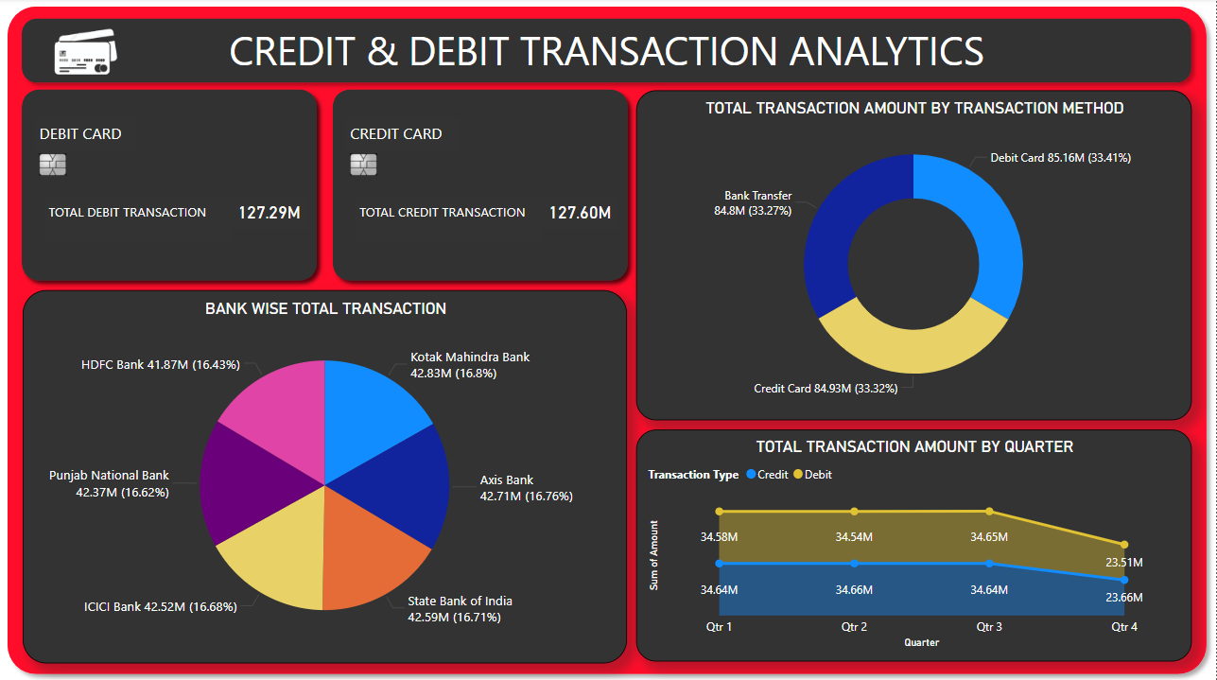
POWER BI DASHBOARD

Slide 9
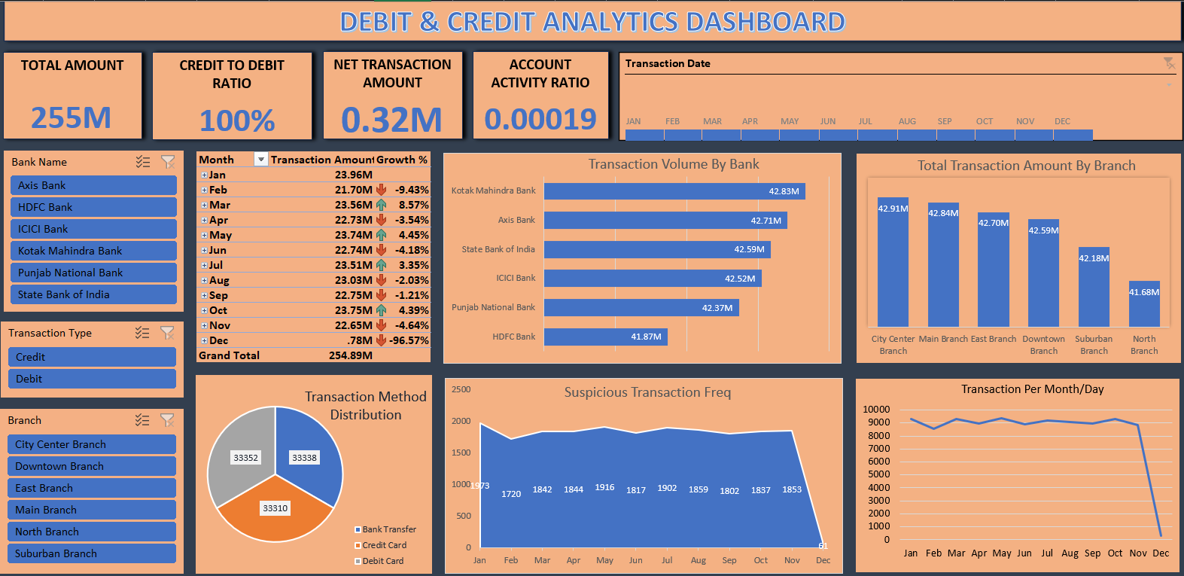
EXCEL DASHBOARD

Slide 10
Double click on file to open

Slide 11
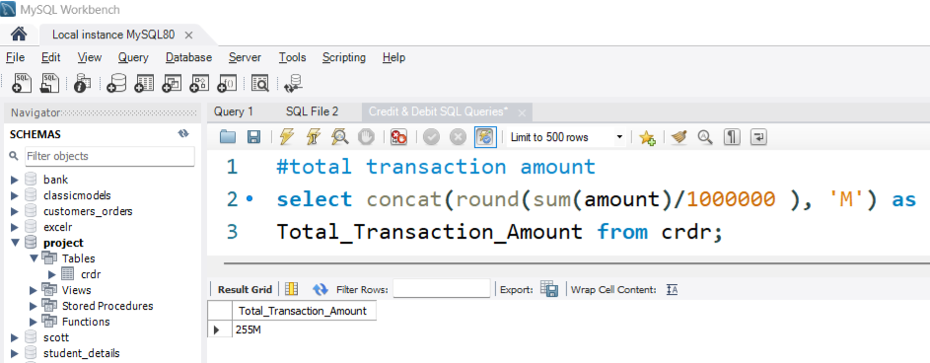
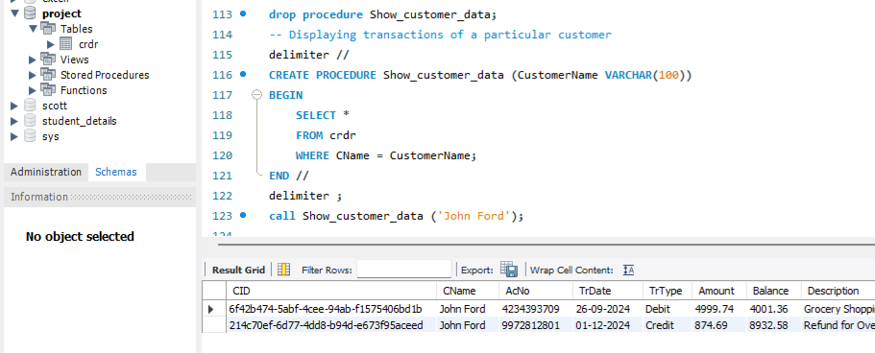
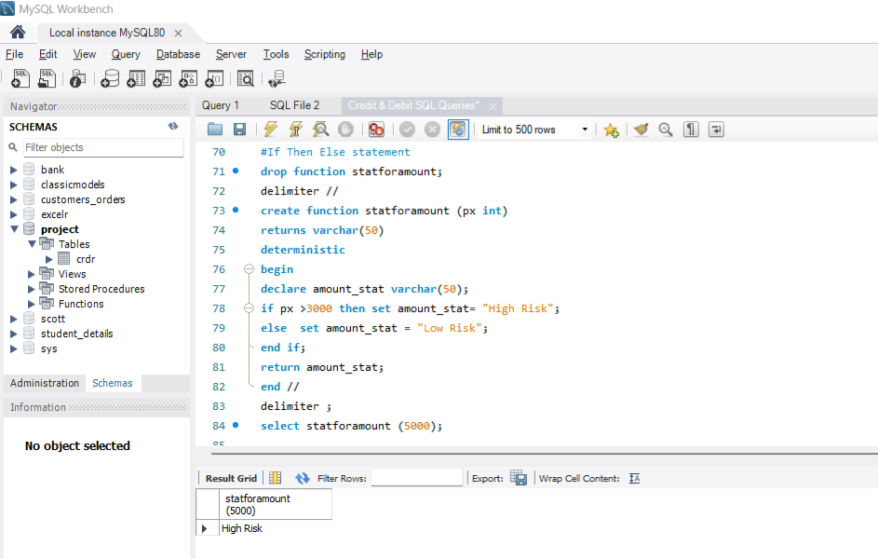
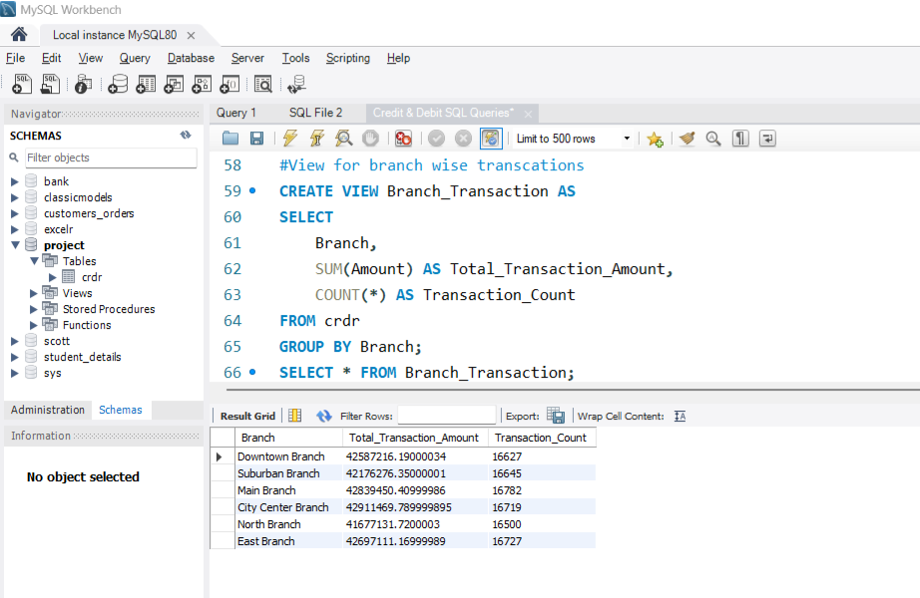
SQL queries with output

Slide 12
RECOMMENDATIONS
Probable reason for undesirable credit to debit ratio can be low interest rate. Banks need to increase the interest rate on savings accounts.
Another reason for undesirable credit to debit ratio can be declining trust on banking system.
To improve the cash inflow, banks can improve the services and can offer better returns.
Poor performing branches need to work on consumer experience.

Slide 13
SUMMARY
This project is about banking transactional data, analyzing which I learnt how bank works and generates profit. I further got the insight on people’s spending behaviour and saving habits.
I got the hands on practice of tools like Advance Excel, power query editor, pivot table, data modelling, Power BI, dax, drill down, drill through, SQL etc.
I learnt how to perform data cleaning, treating null values and handling blanks, merging tables, analyzing data, identifying important columns and key performance indicators, visualizing the data and dashboarding.
I would like to further work on banking data and find insightful information which can help banks taking data driven decisions and perform more efficiently. My analysis will enable banks to improve consumer experience and improve the profitability of the bank. It will ultimately strengthen the India’s banking sector.

Slide 14
THANKYOU
By HARIOM CHAUDHARY

